Slide 1
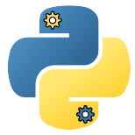
Build Real-Time Systems with Python
Alexander Rössler

Slide 2
Overview
Machinekit and HAL
The 4 APIs
Configure and Run
Create HAL components
Interface with the CNC stack
Remote Control Machinekit

Slide 3
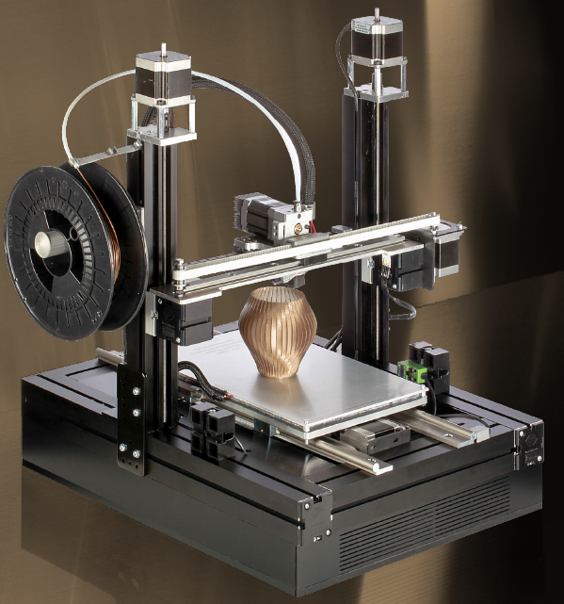

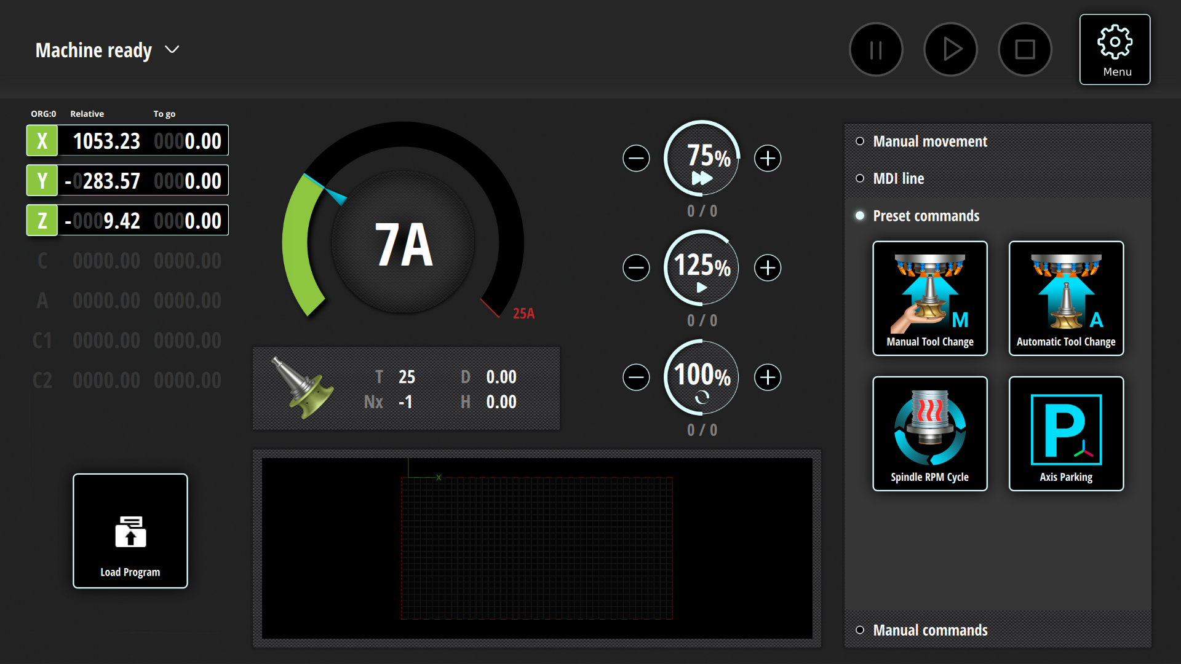

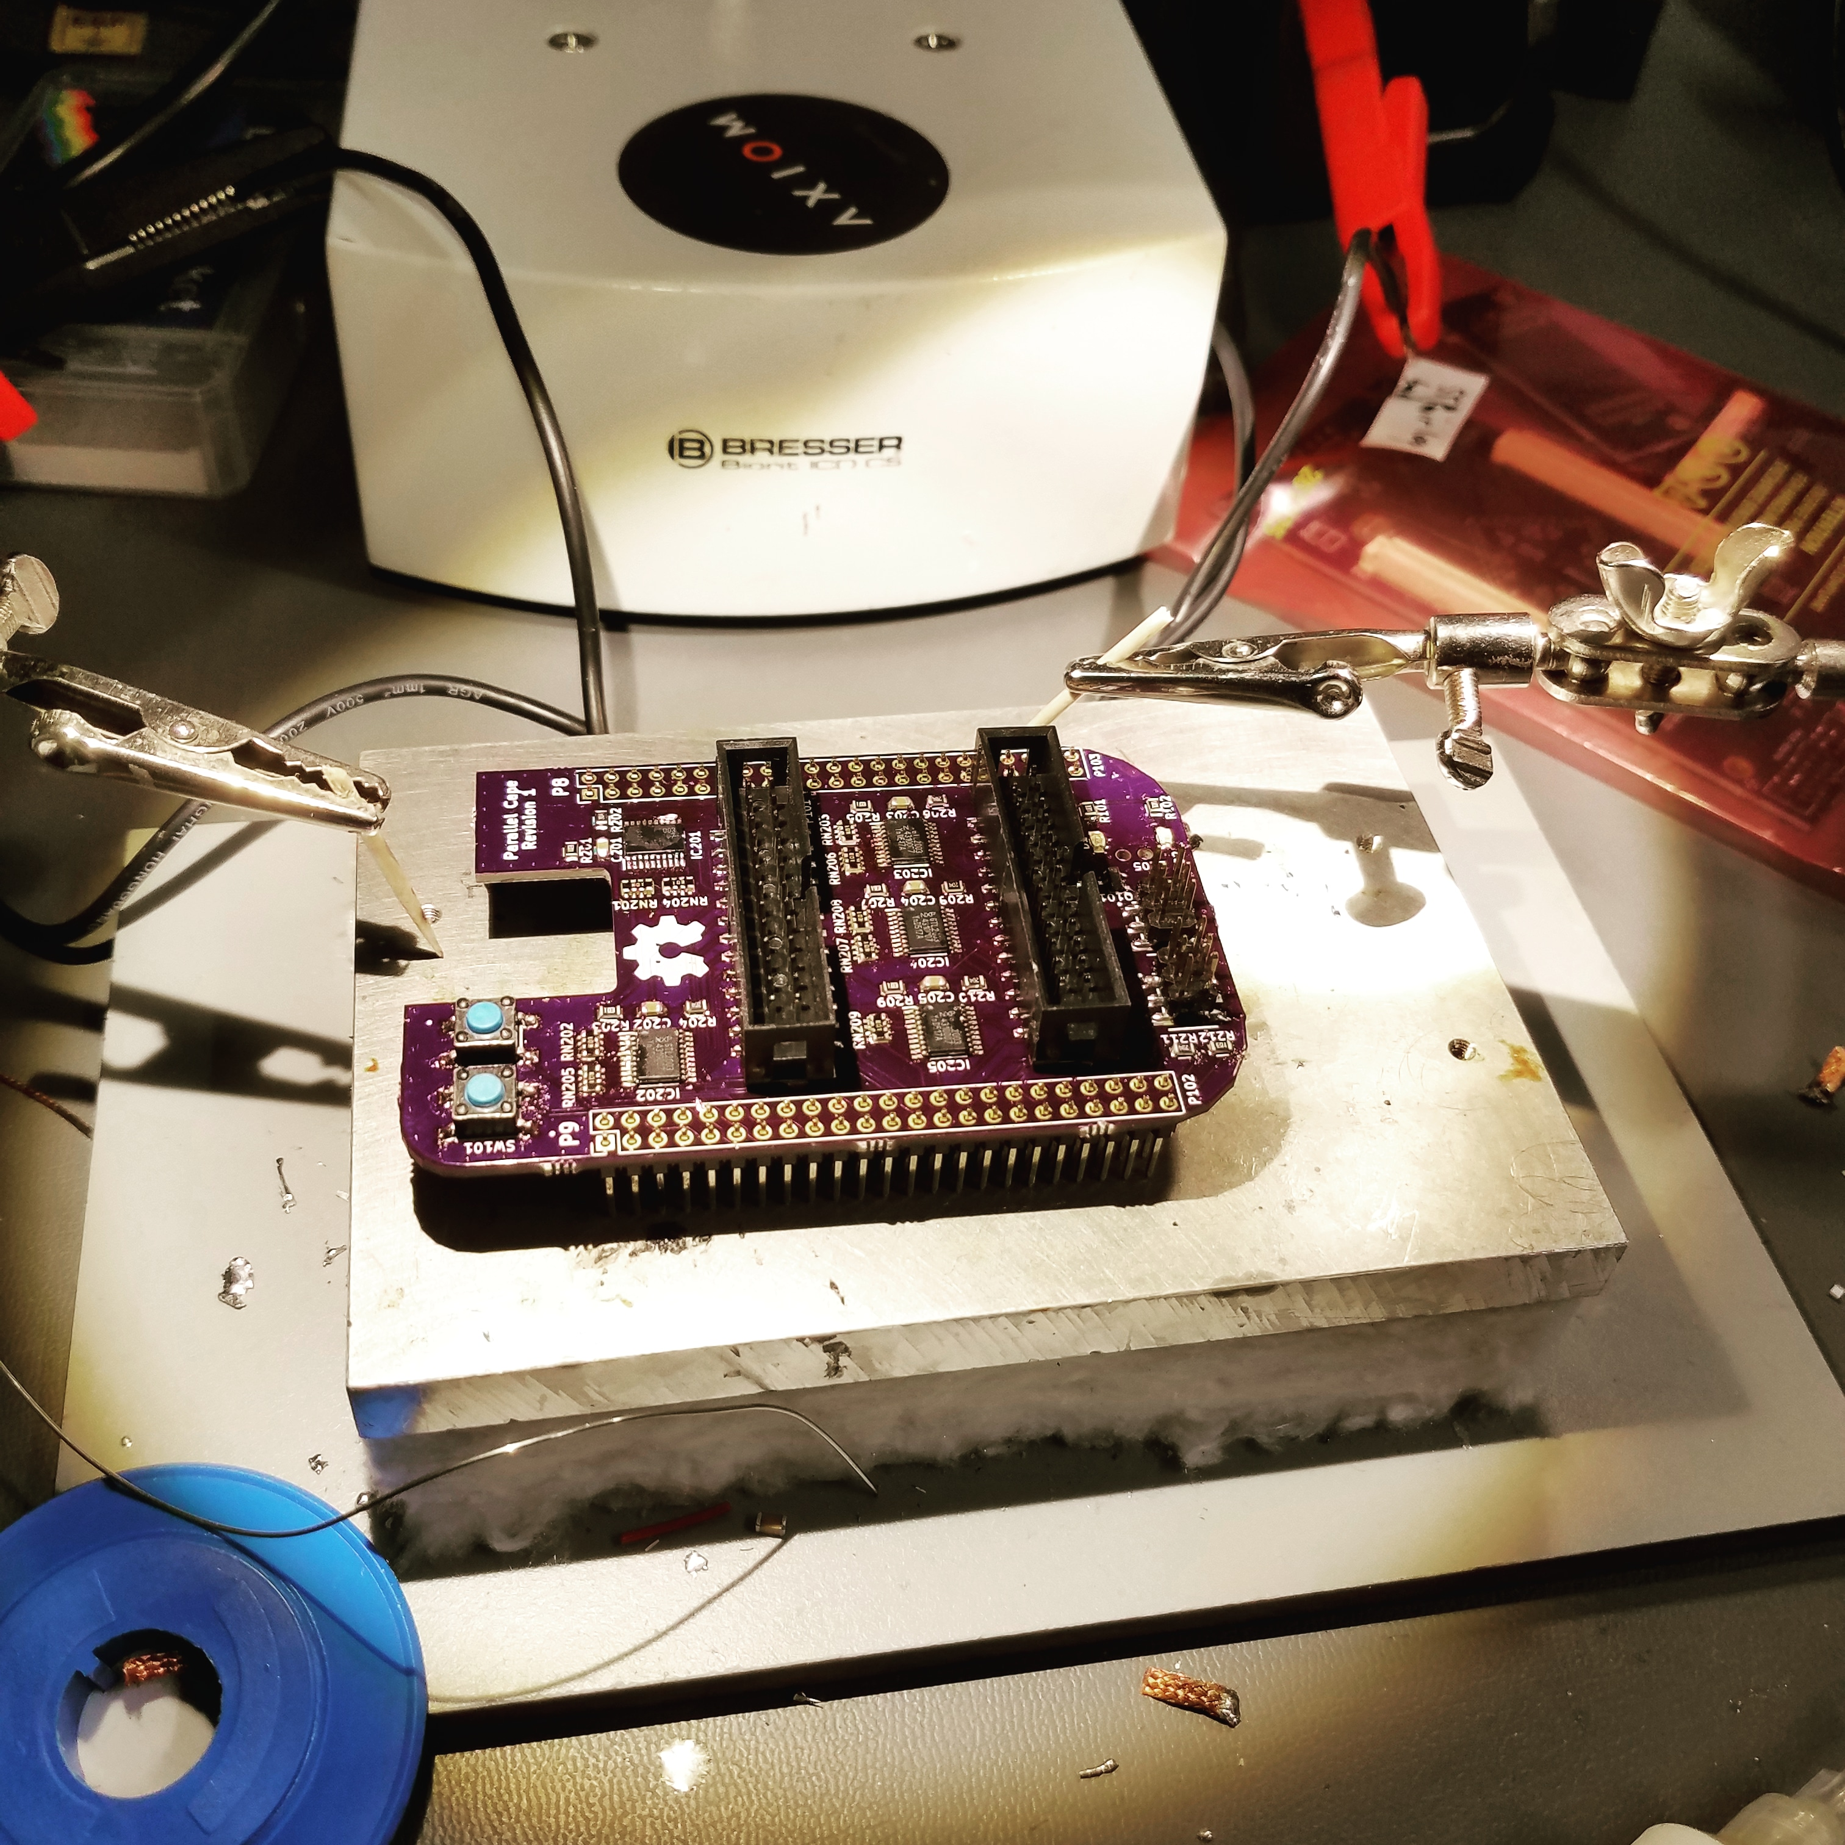
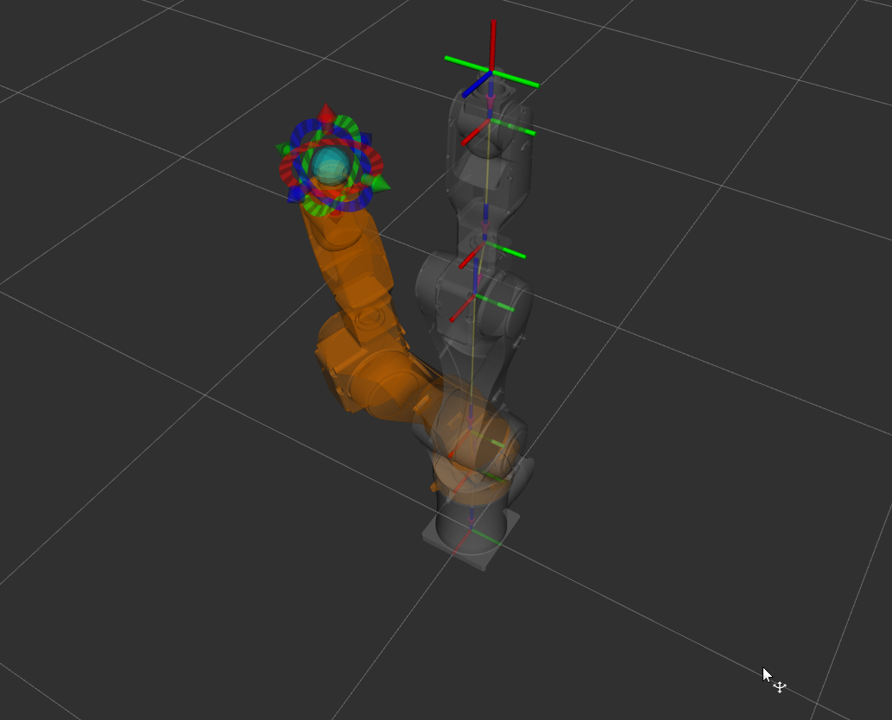
About Me
Alexander Rössler
Embedded Systems
All things Open Source
3D printing, CNC, robots, …
“Solopreneur”

Slide 4
Machinekit and HAL

Slide 5
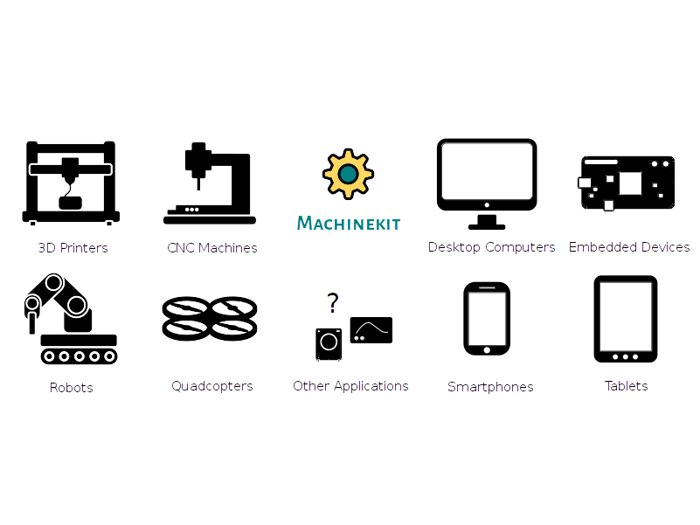
Machinekit

Slide 6
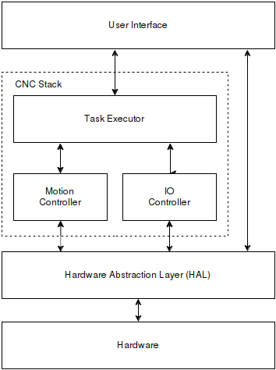
Architecture Overview

Slide 7
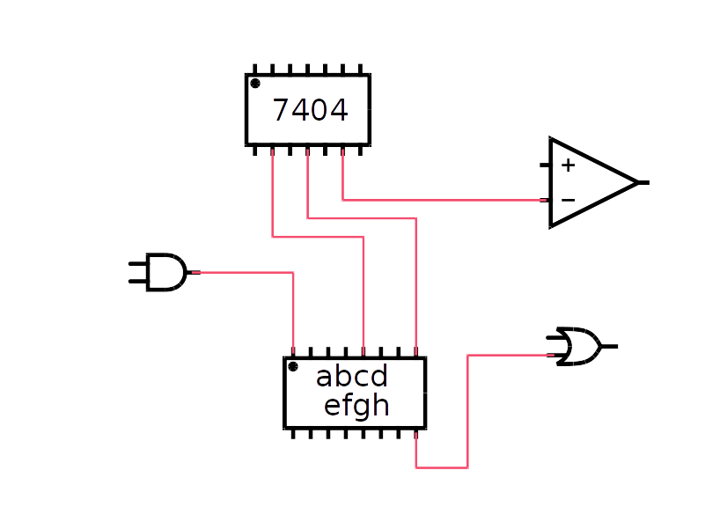
Hardware Abstraction Layer
Configuration
  Components
  Pins
  Signals
Real-Time
Userland

Slide 8
Why Machinekit and not … ?
RT made simple
Portable
Future proof
Runs on Linux
Tools and GUIs

Slide 9
Supported Plattforms
Desktop Linux PC
SBCs
  BeagleBone (Black, Green, Blue, …)
  Raspberry Pi 3
  Altera and Xilinx SoC/FPGA
  …
POSIX, PREEMPT_RT or Xenomai

Slide 10
The 4 APIs

Slide 11
The 4 Python APIs
Python HAL and configuration API
Python HAL component API
Python linuxcnc API
pymachinetalk
...

Slide 12


What can be done with Python
Create HAL configurations
Launch and manage Machinekit/HAL instances
Create Userland HAL components
Interface with CNC stack
Remotely interact with HAL
Extend GCode
...

Slide 13

What can’t be done Python
Create new HAL RT components

Slide 14
Configure and Run

Slide 15
Machinekit Module
import machinekit
  config, launcher, hal, rtapi
src/hal/cython
lib/python/machinekit

Slide 16
Very Basic HAL Application
run.py - Run file
hal_basics.py – HAL config

Slide 17
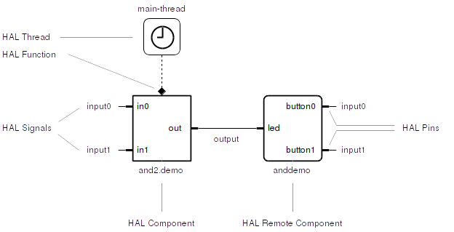
HAL Basics

Slide 18
Tools
halcmd
halmeter
Halscope
hal-graph

Slide 19
Ring Buffers

Slide 20
Create HAL Components

Slide 21
HAL API
import hal
CPython module
Lib/python/hal.py

Slide 22
Simple HAL Component
import hal
Create pins
Update pins in main loop
custom_sum
  in0 + in1 = out

Slide 23
Testing HAL Components
Unit and Integrations tests
Nose

Slide 24
Interface with the
CNC Stack

Slide 25

Linuxcnc Module
import linuxcnc
  stat, command, ini, positionlogger
CPython module
lib/python/linuxcnc.so

Slide 26
Components
Stat
Command
positionlogger

Slide 27
Remote Control
Machinekit

Slide 28
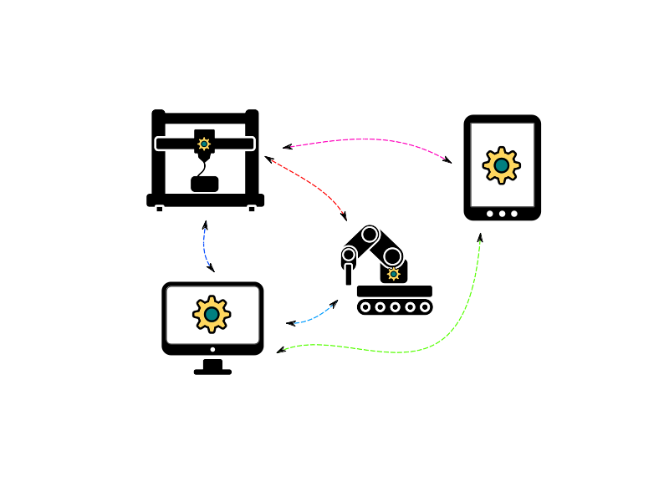
Pymachinetalk
import machinetalk
import pymachinetalk
  dns_sd, halremote, application, ...
Available on PyPI
Python 3 and 2
Windows, Linux, Mac, ...

Slide 29
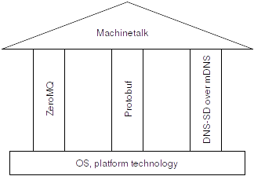
Machinetalk

Slide 30
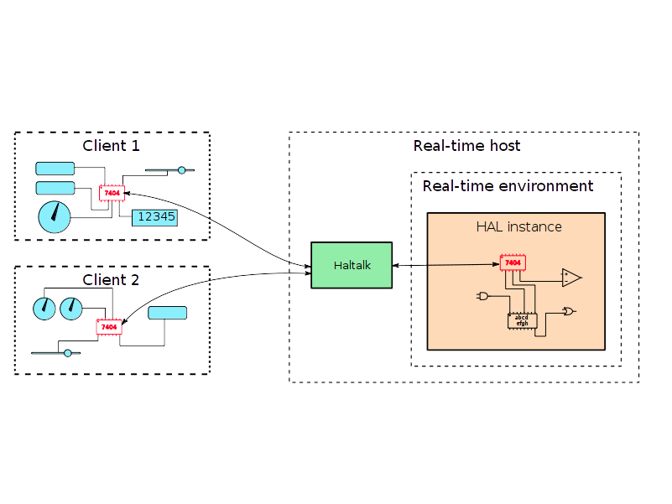
Halremote Service
halrcomp & halrcmd
haltalk
Remote API

Slide 31
Applications
Testing Machinetalk
Remoting HAL
CLIs and UIs
Distritbuted HAL setups
3rd party plugins

Slide 32
Questions?

Slide 33
More Information
http://machinekit.io
https://machinekoder.com
Machinekit on Google Google Groups
https://github.com/machinekit
https://github.com/machinekoder/cookiecutter-machinekit-python-hal

Slide 34


Machinetalk
Middleware
Interaction between RT and non-RT
Distributed setups

Slide 35
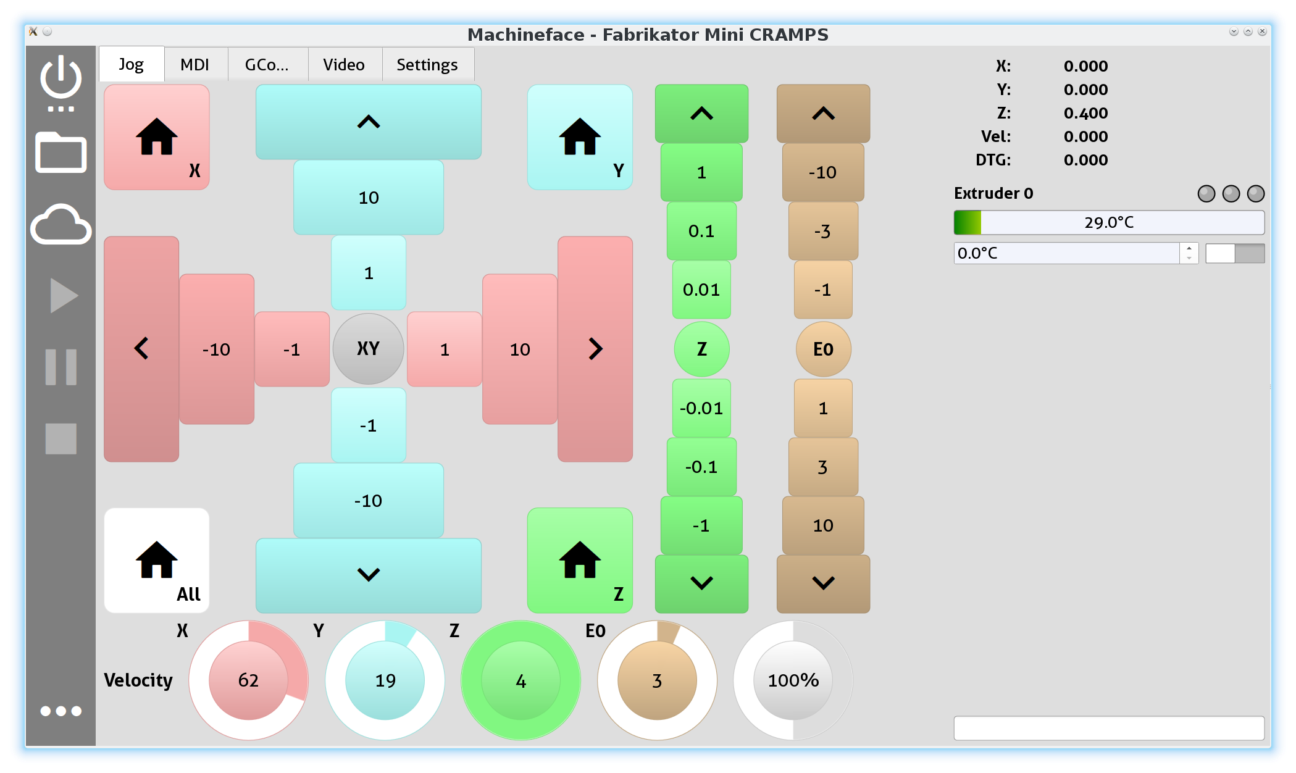
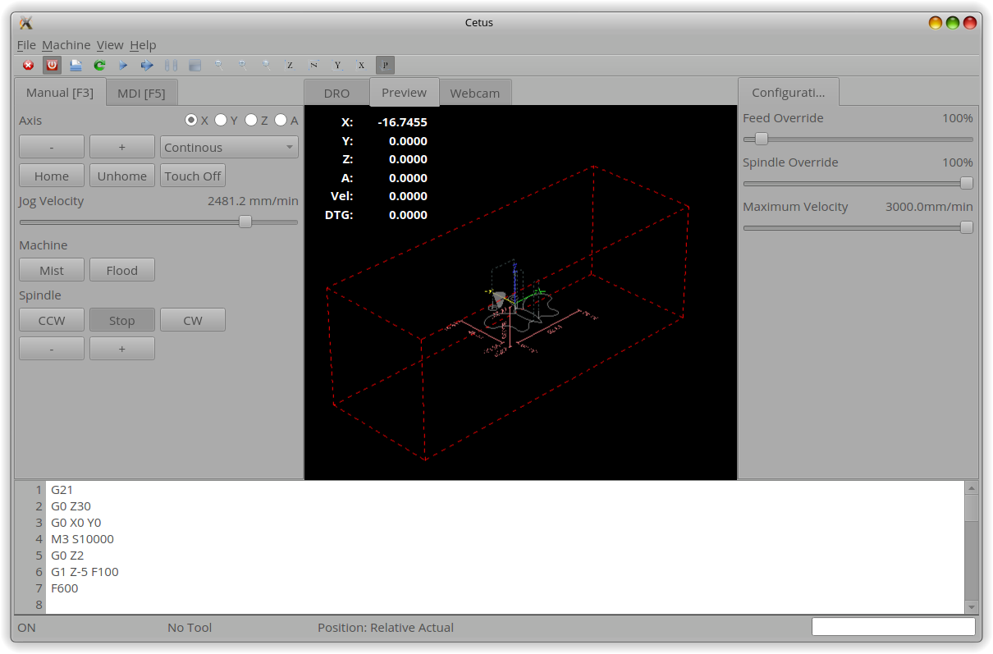
Remote UIs
QtQuickVcp
Machineface
Cetus
...

Slide 36
In Action

Slide 37
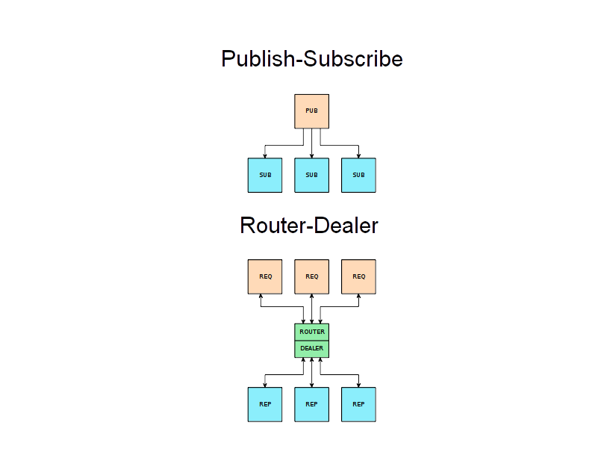
Transport
ZeroMQ
End-to-end
Communication patterns
Several transports (TCP, IPC, …)
No startup order dependency
Automatic reconnect

Slide 38
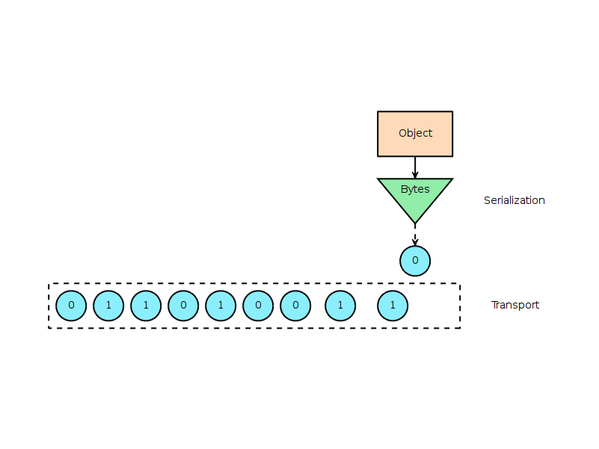
Serialization
Protocol Buffers
Wire format
Binary data
Highly optimized
RT: nanopb

Slide 39
Services
Instances organized in services
Distributed setups
Easy to extend

Slide 40
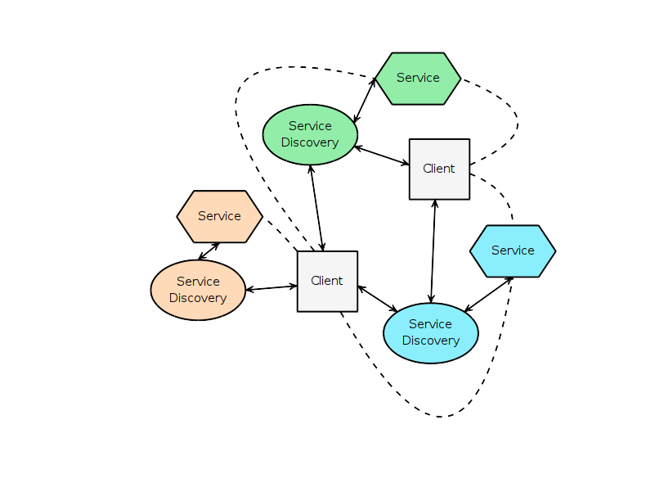
Service Discovery
MDNS/DNS-SD
Auto configuration
No user interaction
Decentralized
Multicast
Unicast

Slide 41
Webtalk
Bridge
Protobuf → JSON
ZeroMQ → websockets

Slide 42
HAL Remote Component
Like normal components
Remote API

Slide 43
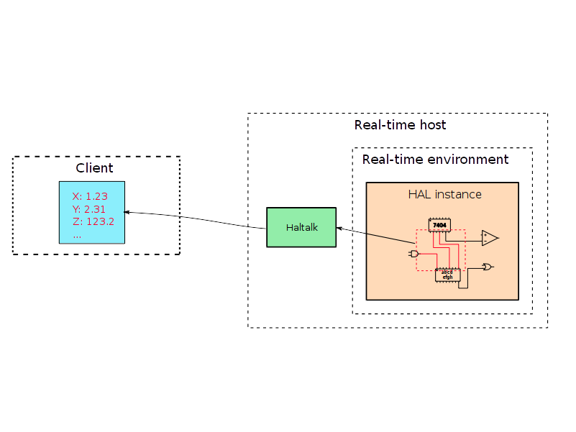
HAL Groups
Grouping signals
Value updates

Slide 44
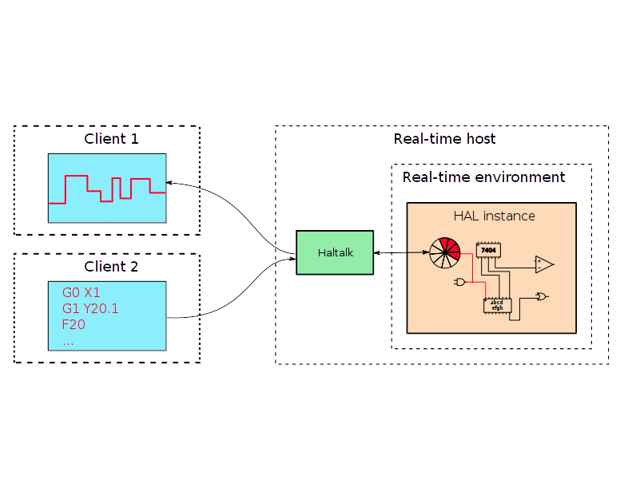
HAL Named Ring Buffers
Queued command and response
RT to non-RT interface

Slide 45
Showtime!

Slide 46
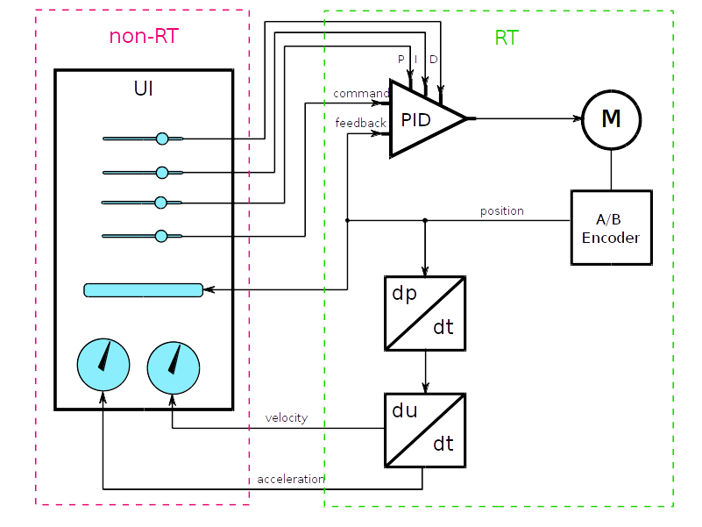
Demo

Slide 47
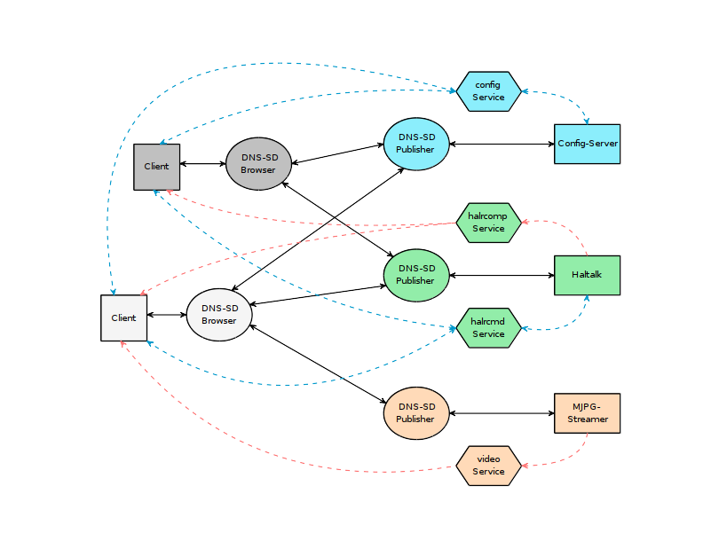
DEMO

